Slide 1
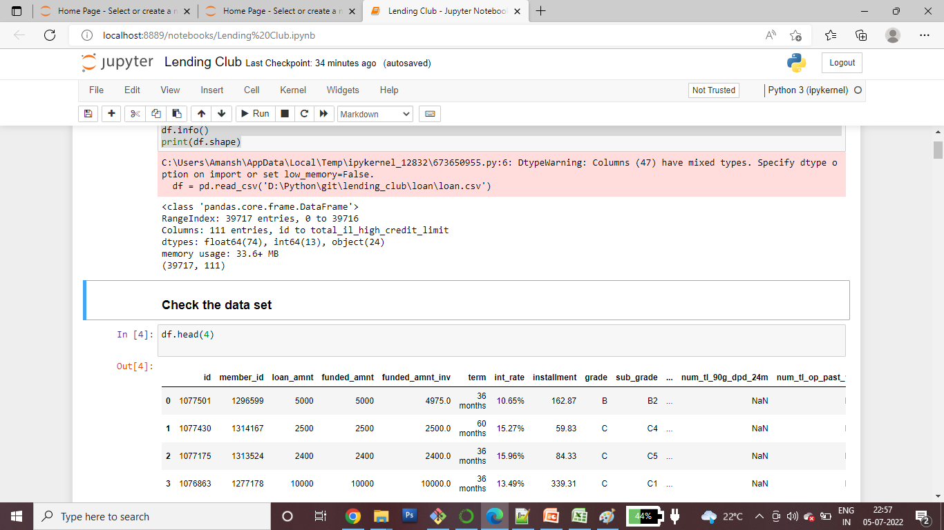
Data understanding
I have gone through the data dictionary file and started understanding the column description and what there meaning to fetch some idea about the relevant column list. Out of 115 columns mentioned we need to do first data cleansing and find the unwanted columns. Hence its started with loading the data set in Data Frame and check the columns and datatype

Slide 2
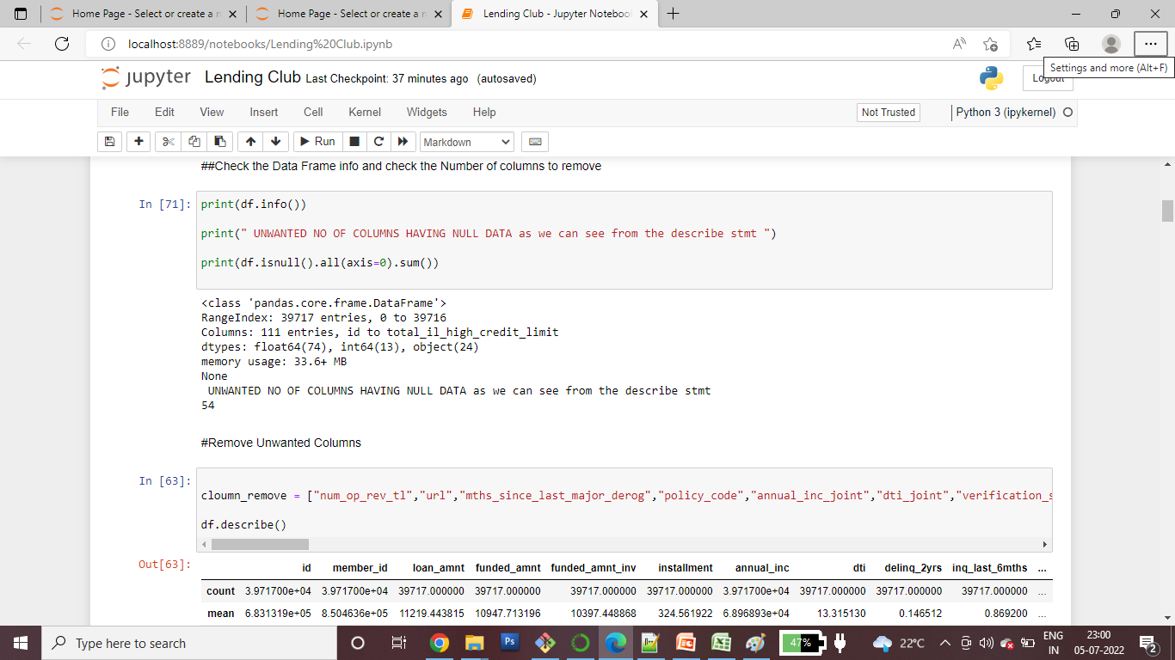
The above snapshot give is a detailed idea that out of 115 columns there are many columns having null record counts and better to remove the below command hel us to find the number of columns having blank records and they can out right rejected total we figure out 54 columns like this and prepared the list to remove

Slide 3
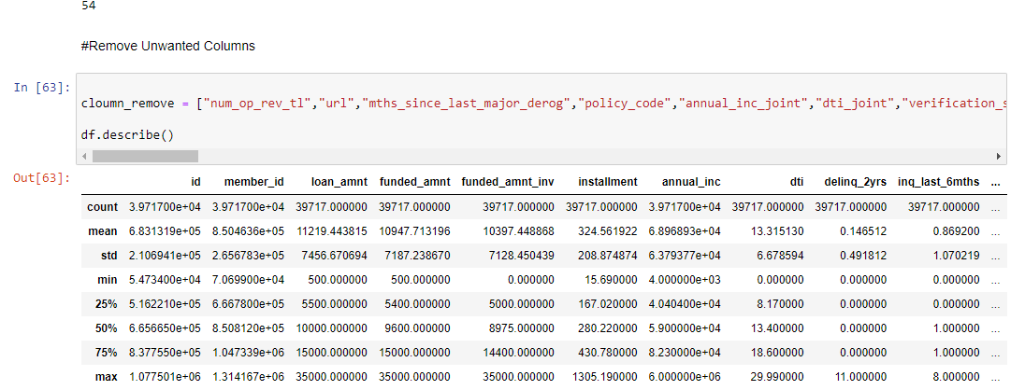
After removing the unwanted columns we describe the data frame to get the idea of actual data, about their min max value and couple of other stats which help us to find the outlairs and meaning ful columns

Slide 4
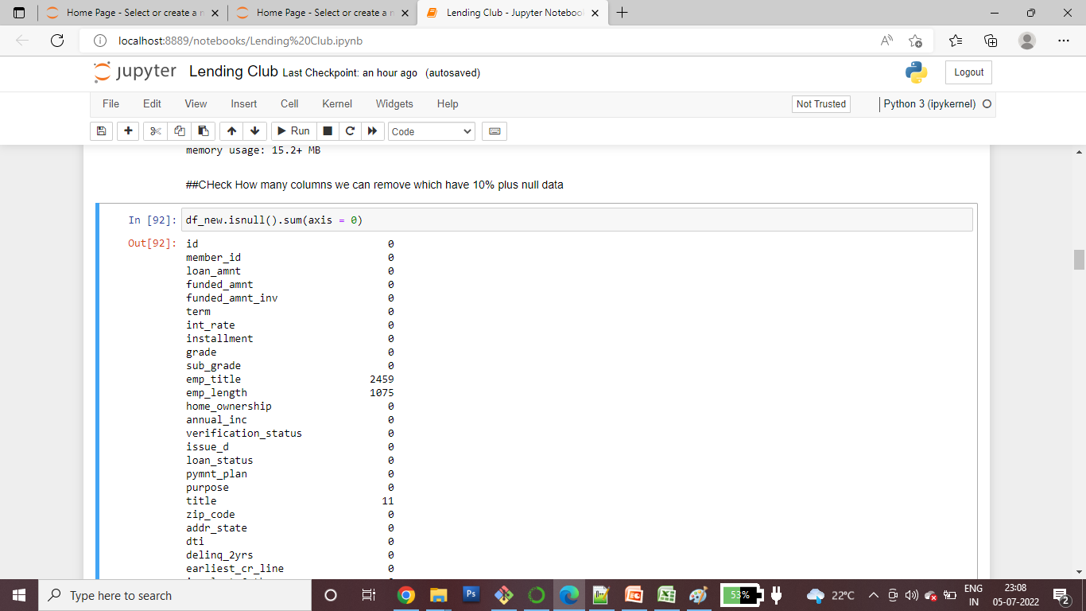
To find out lairs we also have to find the columns having major null data for this we made a rough assumption that 10% of null data to be found and updated

Slide 5
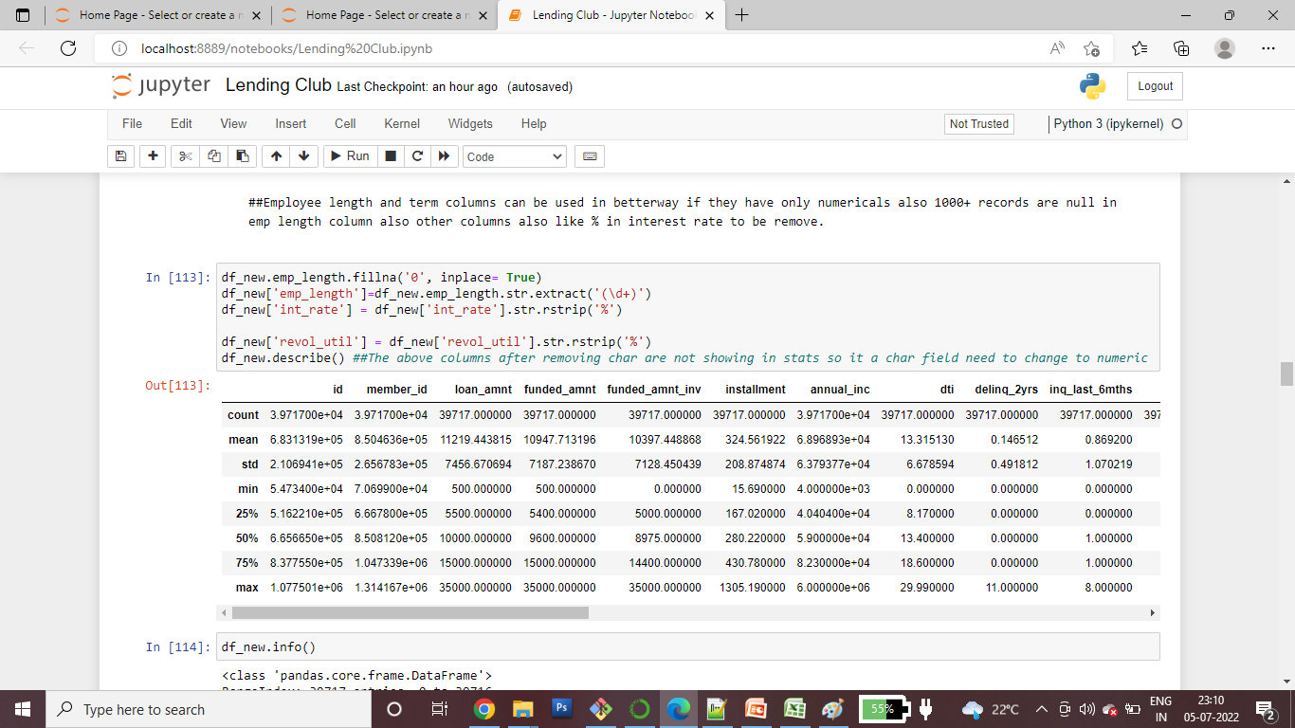
As a part of data cleansing we removed sum more columns and update the null values for example takem employee total service experience and removed all nulls with 0 .

Slide 6
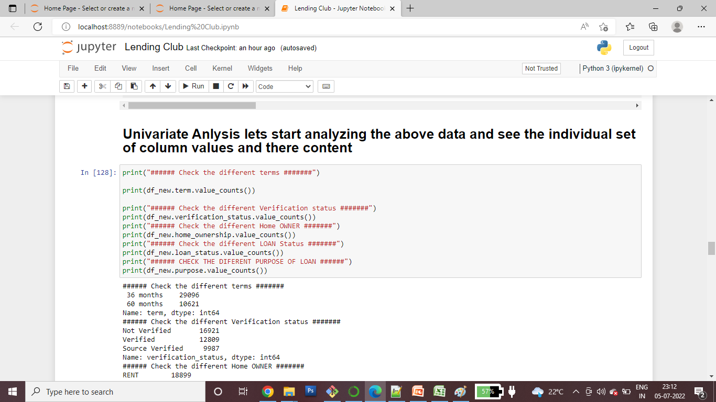
Univariate Analysis We have figured out various columns with the help of which we can draw some conclusion so we atarted to further analyzing the daata like what are the different type of loans offered what is the different status and employees salary range and purpose of loans to draw our conclusion.4

Slide 7
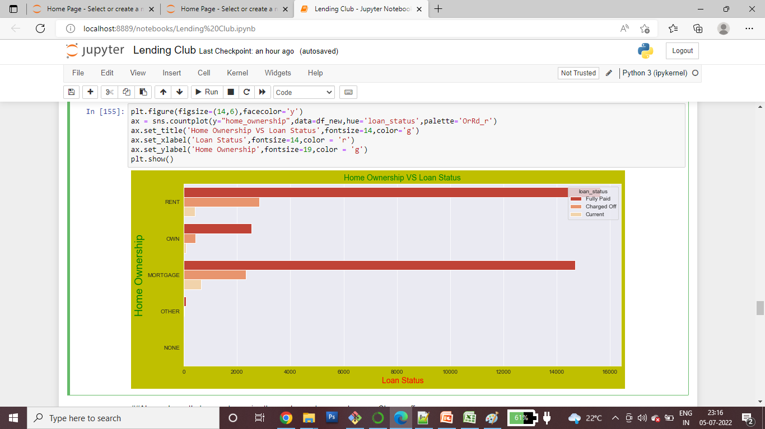
Based on our above univariate analysis we draw some conclusion bycreating different chart patterns mentioned below.

Slide 8
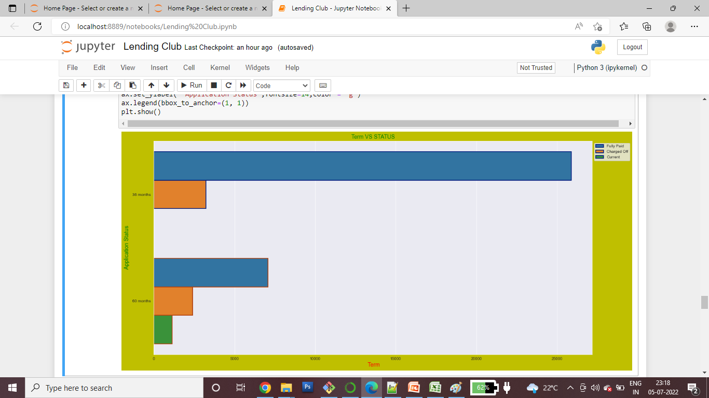

Slide 9
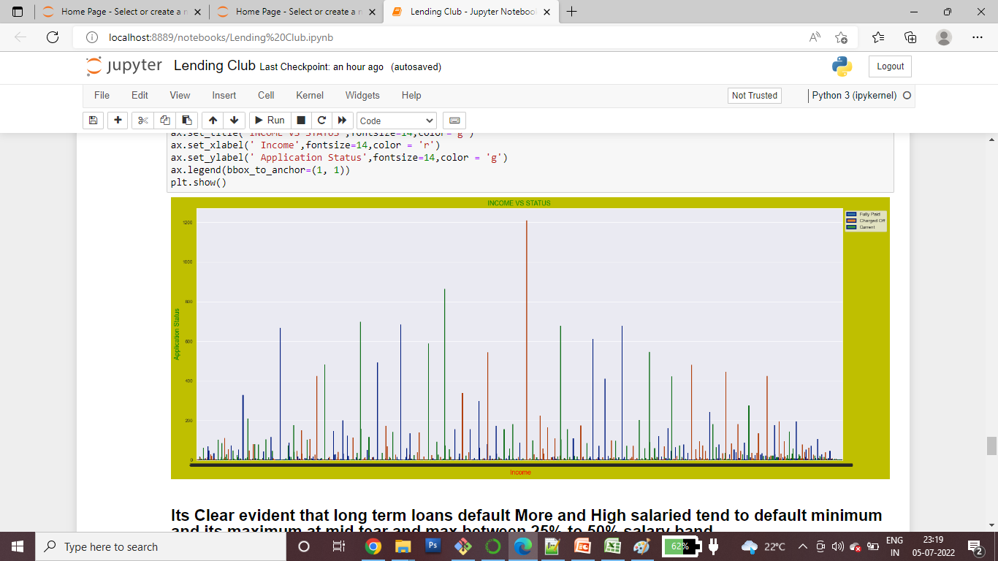

Slide 10
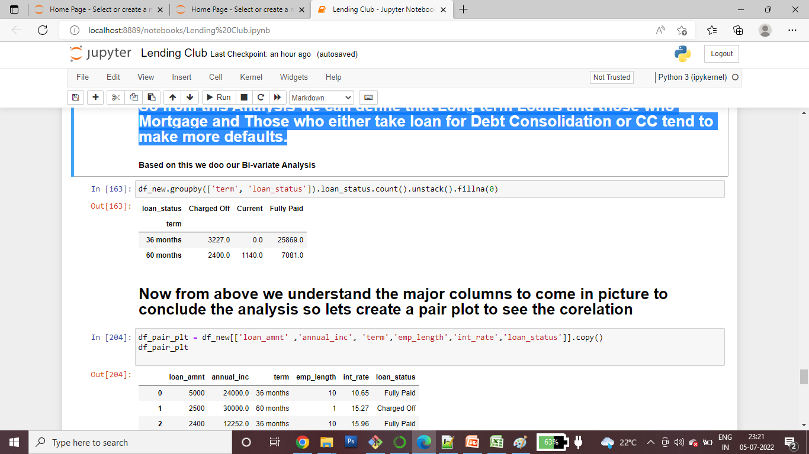
Its Clear evident that long term loans default More and High salaried tend to default minimum and its maximum at mid tear and max between 25% to 50% salary band. So from this Analysis we can define that Long term Loans and those who Mortgage and Those who either take loan for Debt Consolidation or CC tend to make more defaults. So we started by bi-variate analysis We have made some daata rouping to draw our conclusion further that how the data co relates with defaulters.

Slide 11
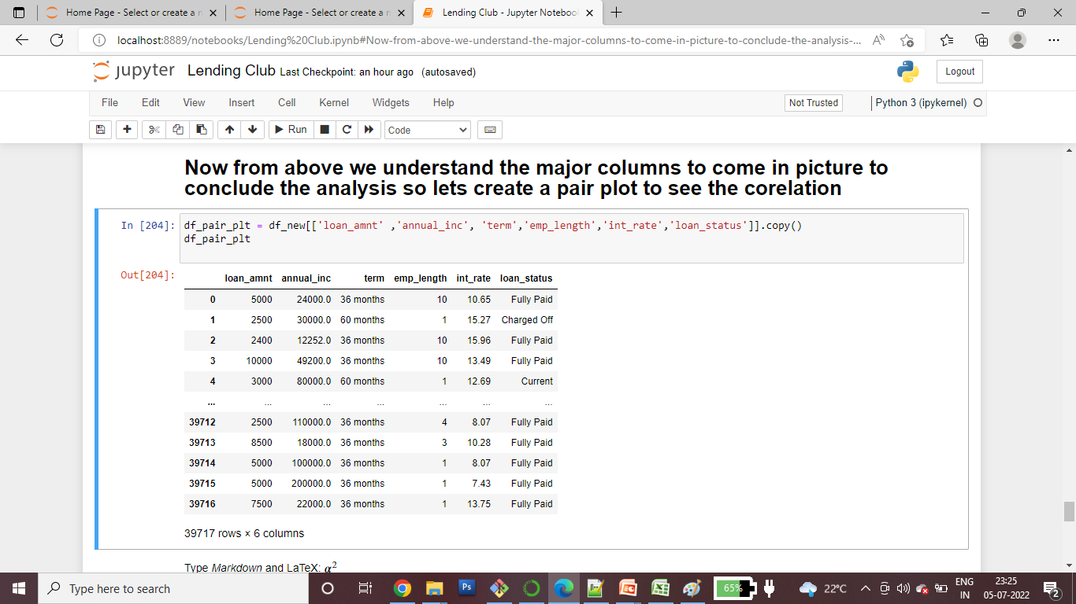
Now from above we understand the major columns to come in picture to conclude the analysis so lets create a pair plot to see the corelation¶ Below stats give us some more light on the charged off loans and the co-relation so we started drawing the pair plot for our final analysis.

Slide 12
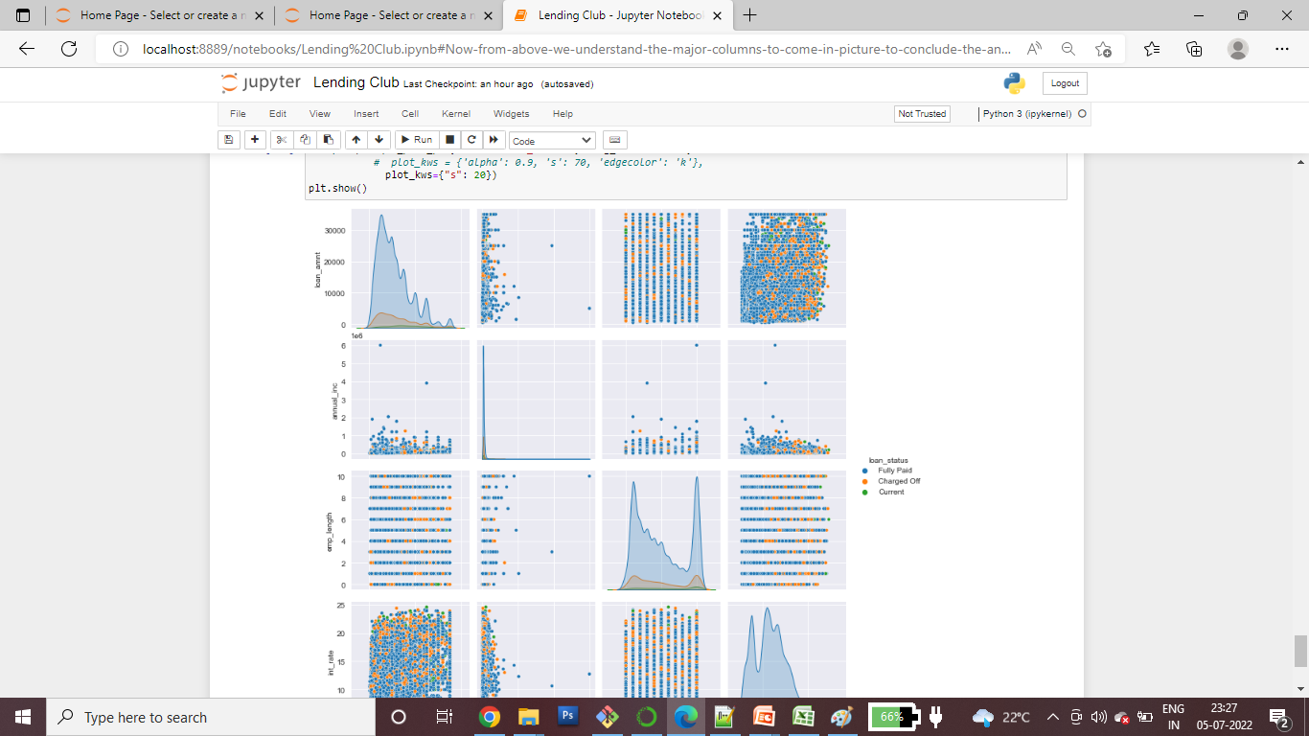
Below pair plots clearly shows the co-relation between the charged off status is increasing for perticular set of loan types and customers So our below is the final conclusion Final Conclusion: 1) Employees with good salary tend to default very less major amount of chargeoffs happened between mid salry range and decrease toward mean 25%. 2) Loans with higher interest rates tend to make more defaults and loans we have seen 36 and 60 months where max default happens for more duration loans. 3) Also people who lives in mortgage property tend to make more charge off.

